Slide 1
Software Engineering Project Wandering in the Woods

Slide 2
Introduction
Purpose:
Case study requirements will be examined, and results will be documented.
For the sake of this guide, we will be using the agile methodology.
Documentation for agile design is not static and is instead subject to change.
In the first iteration, the model of the System Architecture must be defined.
The design models should be defined when new data becomes available. The essential subsystems and components should be there, even if they are not complete.
In line with Agile standards, this document contains just the information that the design team determined absolutely needed to be saved and updated.
In our opinion, this paper represents a working draught of the final blueprint.
Both the paper and the framework may be improved upon by using constructive feedback.

Slide 3
Introduction - Continued
Wandering in Woods:
The game, "Wandering in the Woods," is a relatively simplistic visual aid meant to illustrate the core notion to elementary school children (and maybe entertain them).
Students in grades three through five will be exposed to "little data," or information generated by one's own actions, in a manner that requires them to make decisions, evaluate data, and tackle further challenges.
The sixth through eighth grade level will get a more advanced version that will require students to work with larger and smaller datasets, generate charts, and make decisions that significantly alter the data.

Slide 4
Process Model
Process models allow organizations to visualize how their internal business processes work to better manage and optimize them.
In most cases, this is a continuous improvement exercise performed in an agile manner.
The game will be designed using evolutionary process model which is the software development life cycle evolution model combines the iterative and incremental approaches.
With the help of the evolutionary development model (EVO), products that better meet the demands of their target audience may be created at lower cost and with less risk, and incremental enhancements can be made to current products more quickly.
The evolutionary approach recommends modularizing the project into manageable pieces, ranking them in order of importance to the client, and delivering them in stages.

Slide 5
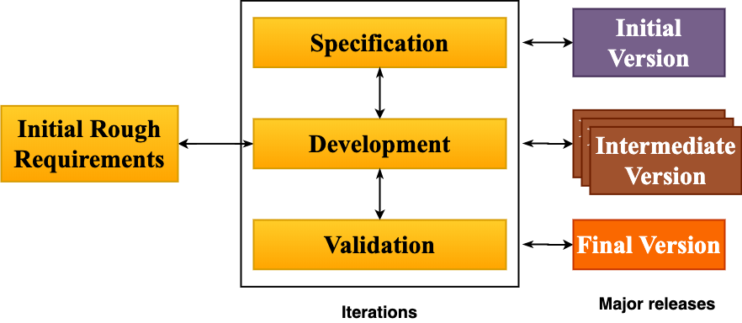
Process model – Graphical Representation

Slide 6
Use Case
In use cases, users are described as performing specific tasks on system. In it, the behaviour of a system is described based on the point of view of a user.
In each use case, users' goals are the starting point, and the goal is achieved at the end.
As well as explaining how the system should behave, use cases also help brainstorm what might go wrong.
Use case : Start Game
Use case : Play Game
Use case : Choose Stage
Use case : View Statistics
Use case : Replay Game
Use case : Exit Game
Use case : Move Diagonal
Use case : Move Random
Use case : Change Grid
Use case : Play Challenges
Use case : Test Variety of Wandering methods

Slide 7
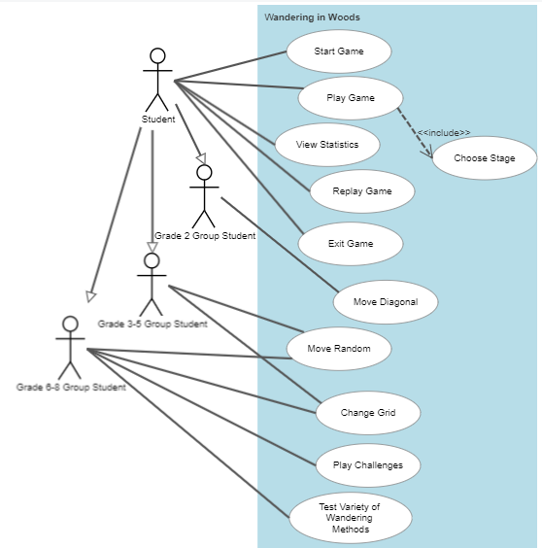
UML Diagram – Use Case Diagram

Slide 8
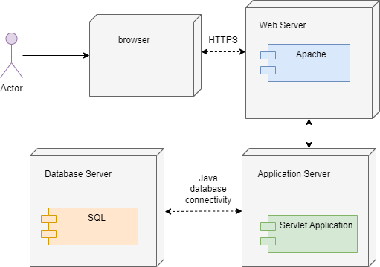
UML Diagram – Deployment Diagram

Slide 9
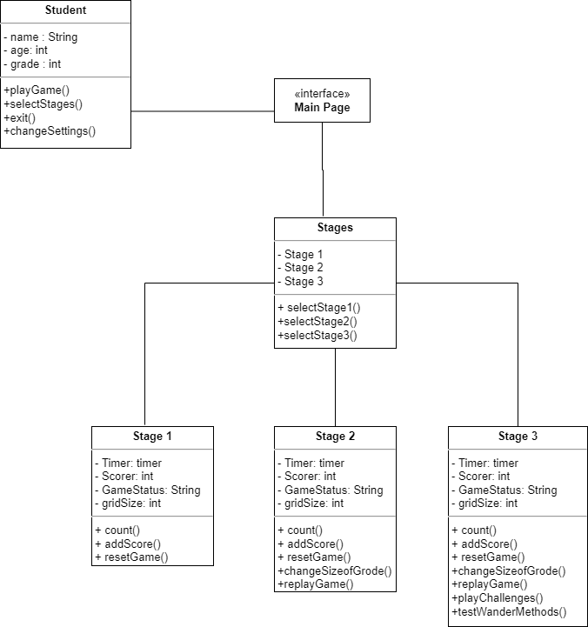
UML Diagram – Class Diagram

Slide 10
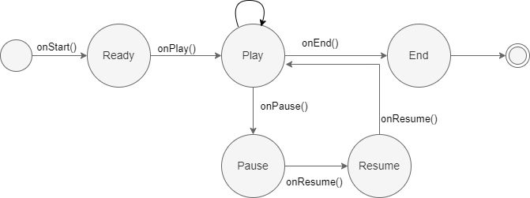
UML Diagram – State Diagram

Slide 11
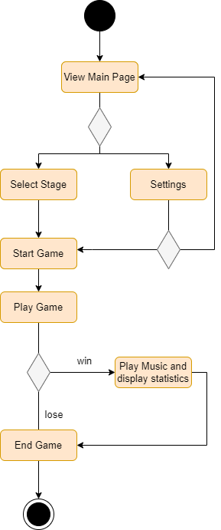
UML Diagram – Activity Diagram

Slide 12
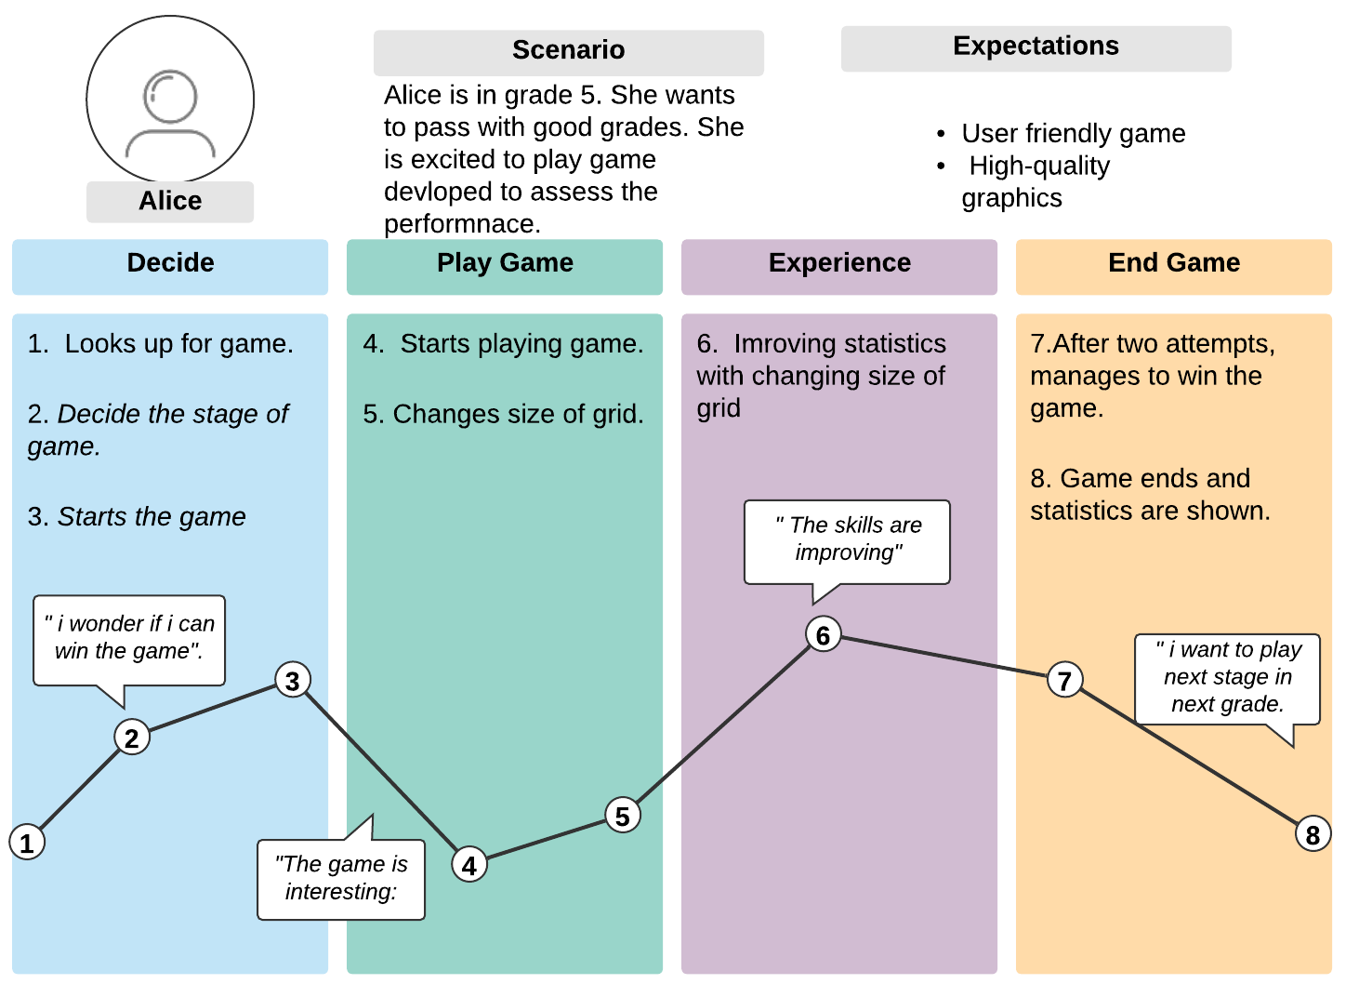
Customer Journey map
Customers' journey maps (also called user journey maps) demonstrate how their interactions with your brand work.
Businesses can use this exercise to view their business through the eyes of their customers.
Using it allows you to find out what customers are most unhappy with and how to improve them.
The customer journey map illustrates the relationship between a brand, service, and product from start to finish.
An organization can gain a better understanding of its customer's needs, processes, and perceptions by creating a journey map.
Design teams use customer journey maps to learn how customer expectations are met and determine what needs to be improved.

Slide 13
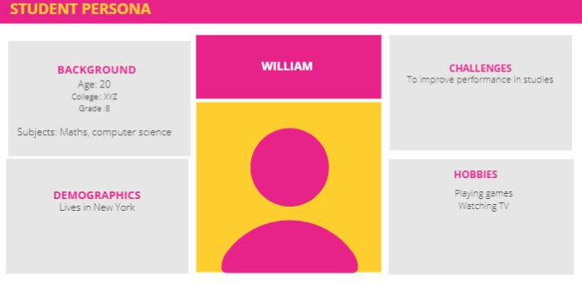
Persona
User personas are archetypes of users that designers and developers can use to empathize with them.
Creating personas can help you step out of yourself. In addition to helping, you understand and identify with the needs and expectations of different users, designing for them can help you recognize their differences.
After analyzing the system, the designers have identified a user, who is student of 8 grade and is weak in some subjects.
He is fond of playing games.
So, this game will help him a lot.
But he may face some new challenges in game, so hints should also be provided, and interface should be easy to navigate.

